Slide 1


Deliverable 2 Team Technical Presentation SEXUALLY TRANSMITTED DISEASES INFORMATION APP
Across The Board Champion
Yoshihisa Miyamoto (Presenter), Changrui Zhang (Presenter), Anil Gadgotra, Divya Datla, Xueting Chen, Prashanth Subrahmanyam
CS6440: Introduction to Health Informatics
March10th, 2019
Notes:
Hi, today we are going to present the technical aspect of our project

Slide 2
Video Link to Presentation
https://youtu.be/ckTnW2uDckE

Slide 3
Agenda
Architecture Diagram
Technologies
Gantt Chart and plans for the next few weeks.
Further research and next steps
Notes:
Agenda for this deliverable are, Architecture Diagram, technologies, updated Gantt chart and plans for next few weeks and further research we’ve have done so far and what our next steps will be.

Slide 4
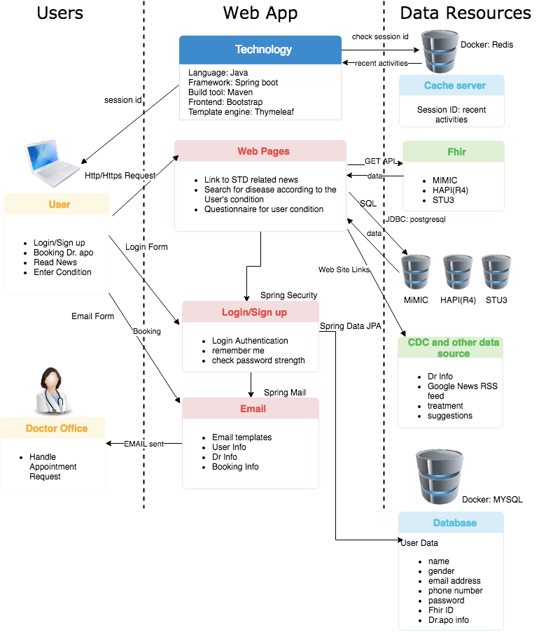
Architecture Diagram
Notes:
Our system can be separated into 3 tiers. Users, Web app and Data resources.
Users will access our website with https protocol which is secure version of http. Once they login, the session id will be produced and send it back to the user as a form of cookie or in the response header. the user information such as name, gender, email address and so on will be stored into the database which is MYSQL.
The session id and the other data associated with it will be stored in the cache server which is redis so next time user comes back, we know the user’s recent activities. Cache server will be fast in read and write and will help relieve too much load on the database.
We will use FHIR, CDC and other website for our data resources. FHIR will be accessed through API or alternatively by querying directly to the database server.
Dr. appointment will be handled by email. Login and Email system will be provided by Spring framework libraries.

Slide 5
Technologies
Application
Reason for the choice
Language: Java 1.8
Framework: Spring-Boot
Build Tool: Maven
Frontend: Bootstrap
Template engine: Thymeleaf
Fully supports TLS1.2 and TLS 1.3 for secure communication
Easy configuration and local development with embedded tomcat
Familiarity, used in Fhir startup proj. could be Gradle.
Responsive and easy to use
Spring-boot recommends
Data Resource
API to Fhir or SQL to postgre data source
Web Links to CDC and other data sources
From HDAP guide, we could get the data by API or SQL,
though database access could be difficult from local dev
as we might need to be on VPN
Web Links and video for Disease treatment, suggestion and news
Data Storage
MySQL(Docker)
Redis(Docker)
Both will be using Docker images to run.
Redis Cache server is storing session id to keep track visiting multi pages
Development
IDE: IntelliJ
All team members are familiar with
Notes:
Now let me explain each technology.
For application, the language we will use is Java 1.8. It supports TLS1.2 and up for secure communication.
Framework for Java is Spring boot. it has very easy configuration and very convenient for local development because of its embedded tomcat.
Build tool we will use is maven.
Frontend framework will be bootstrap which is very popular framework for its responsiveness and it is easy to use.
Template engine for this Java project will be Thymeleaf as Spring boot recommends.
Our data resources will be FHIR, CDC and other websites.
Data Storage will be MYSQL and Redis for cache server. Both will be running as Docker containers for easier networking between the components.
Finally IntelliJ will be our IDE as our all team members are familiar with it.

Slide 6
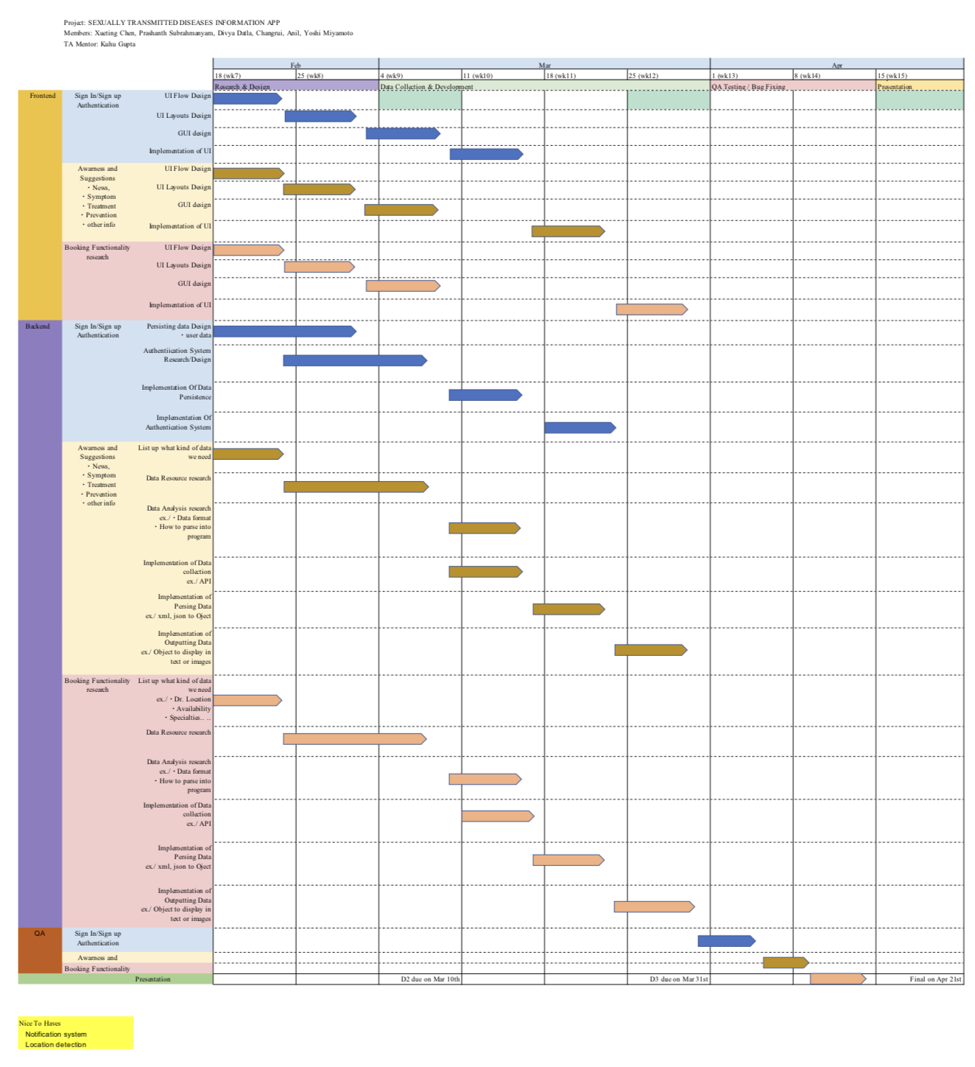
Gantt Chart
UI Design (Divya and Xueting)
Data Research and Integration
Sign in/up (Anil and Xueting)
Booking (Anil and Xueting)
Suggestion (Changrui)
Awareness (Prashanth)
Architectural Design (Yoshi)
Database Design (Anil)
Notes:
Now, let me introduce our team roles and report the progress.
We have six members in our team. Xueting is project manager and Prashanth and Anil will take frontend and Yoshi, Divya and I will take backend.
In last two weeks, we have completed data research and integration and finished the UI, Database and Architectural design.
Everyone was engaged in the project.
This is the updated Gantt Chart. Everything goes well and tasks was done as we planned.

Slide 7
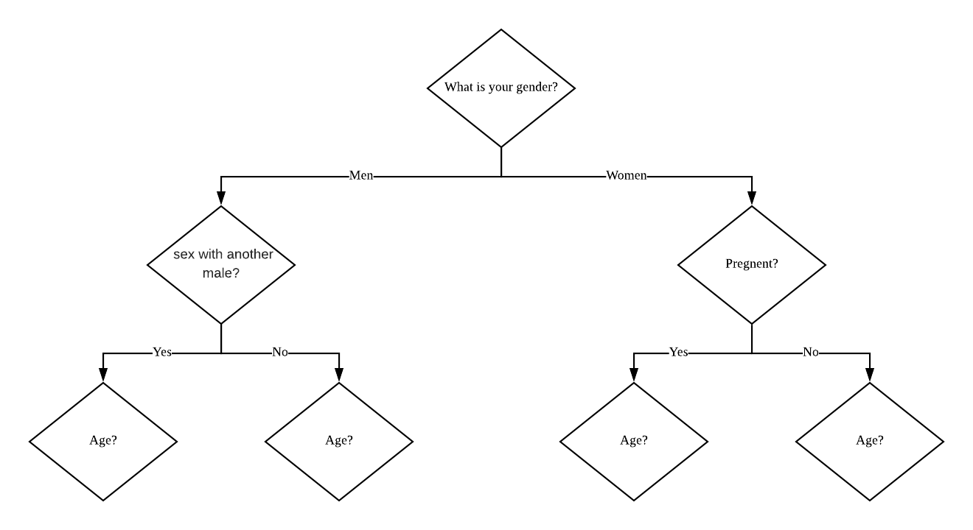
Further Research
Done
Get to Know STDs
Questionnaire Design
To Do
Frontend Implementation
Backend Implementation
Notes:
In addition to the tasks listed on Gantt Chart, we have done some further research.
First, everyone took two STDs and went through the fact sheets, statistics and treatment from Centers for Diseases Control and Prevention.
This help us to learn more about the facts and treatment about STDs.
Second, we design a questionnaire according to the 2015 STD Treatment Guidelines so that we can give a user test suggestion according to his or her answers to the questionnaire. The procedure is shown in picture.
From next week on, we will start frontend and backend implementation.

